Slide 1
Meet
the shortcut for colorful life
9916031 Mark Chao
9916026 Ari Chong
9916037 Ray Cao

Slide 2
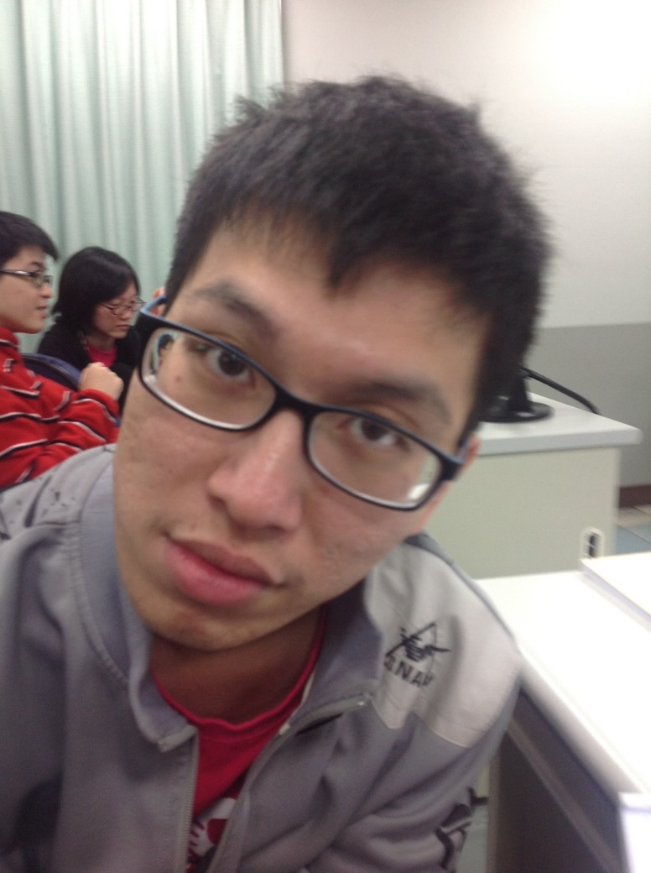
His name is Ray Cao
First,we want to tell you a story

Slide 3

Ok… But what’s wrong about this guy?

Slide 4
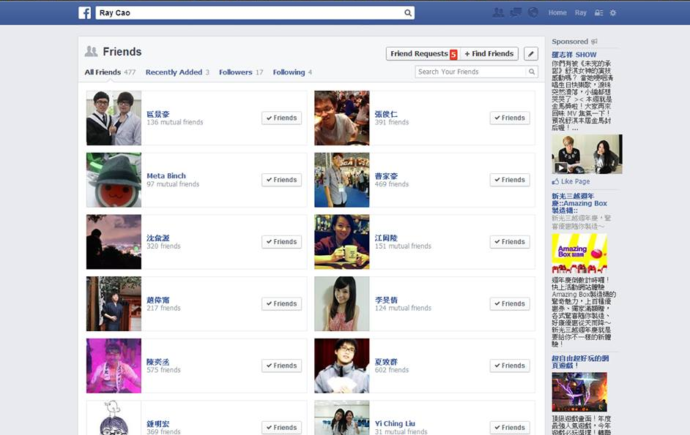
He has 477 or more friends in his Facebook.

Slide 5
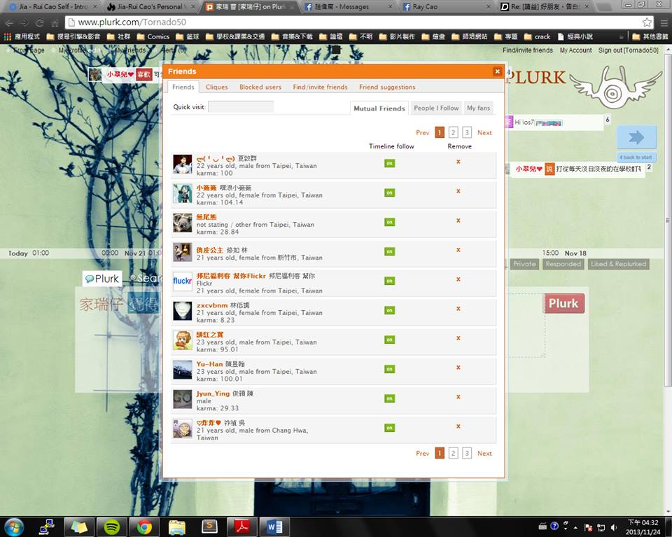
And 25(or more) in his Plurk

Slide 6
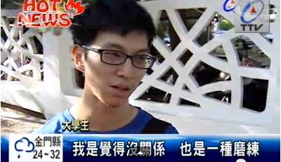
But he is a loser.

Slide 7
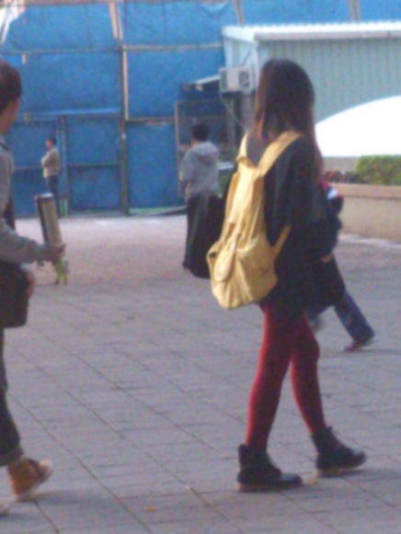
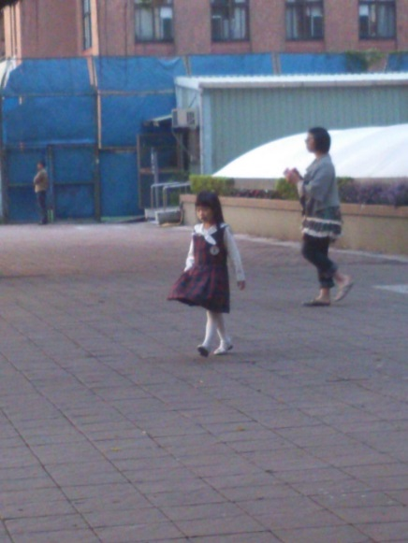
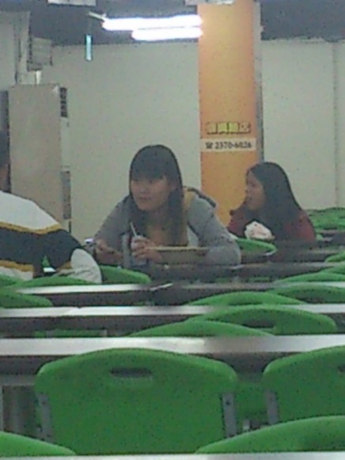
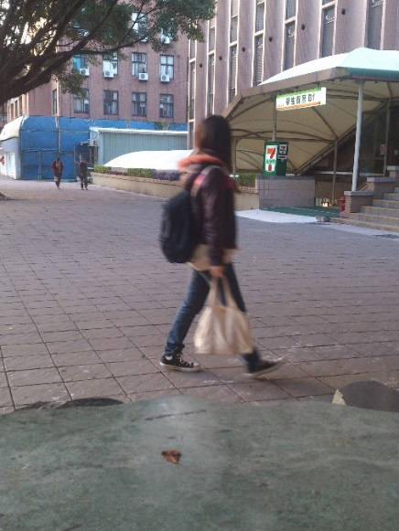
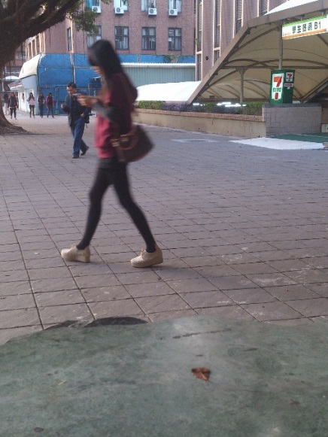
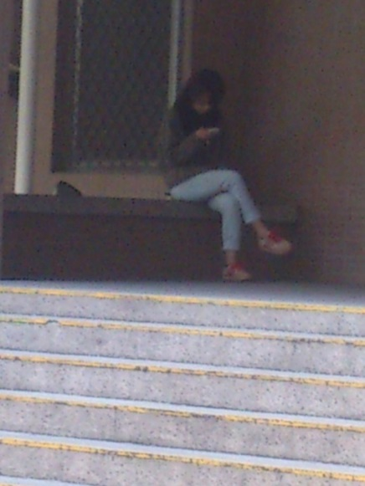
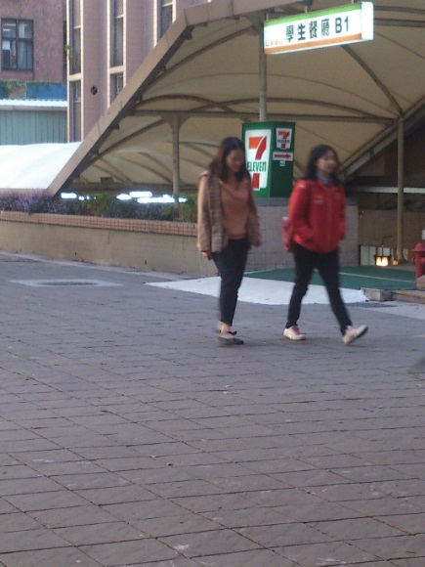
He can meet at least 1000 girls a day.

Slide 8
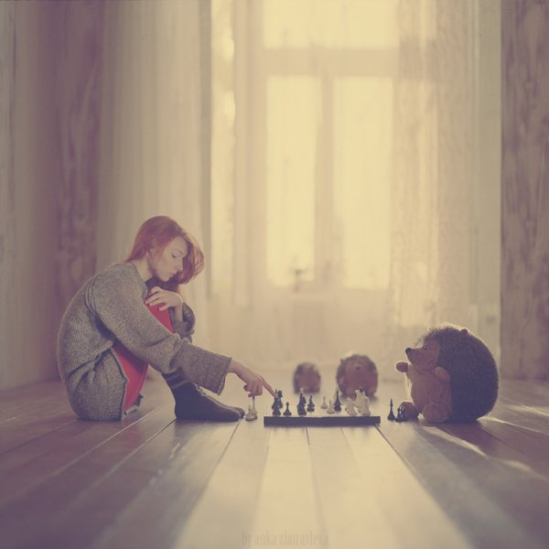
But no one he can have a talk with , just because lack of chance.

Slide 9
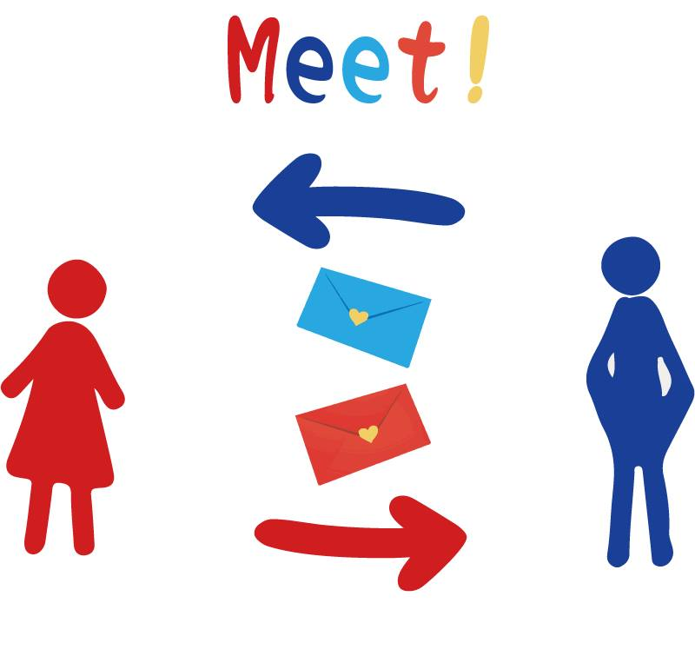
That’s why we create this app called “Meet”

Slide 10

It can give you a big chance and courage to do something that may change your “normal” life!!

Slide 11
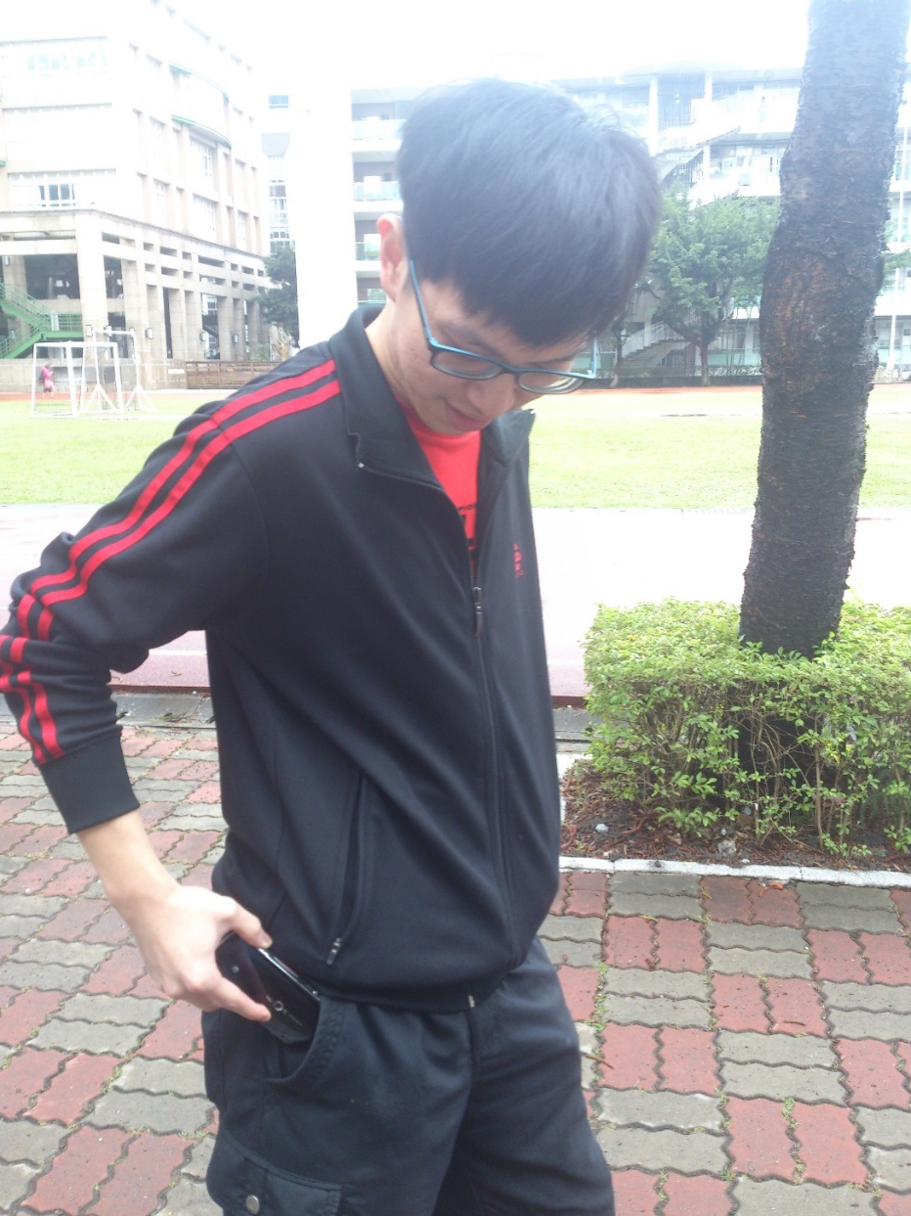
When you walk on the street

Slide 12
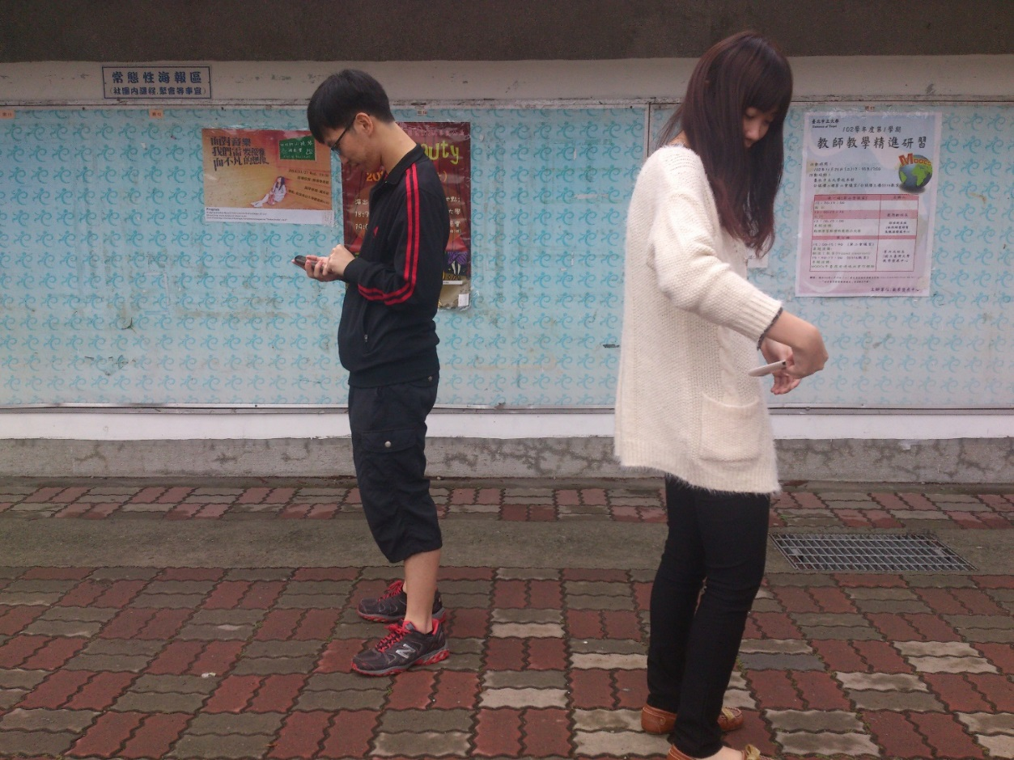
This app will find some one match with you based on your hobby or others.

Slide 13
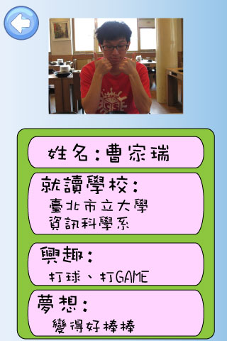
Each one will receive a card which is the other’s basic information.

Slide 14
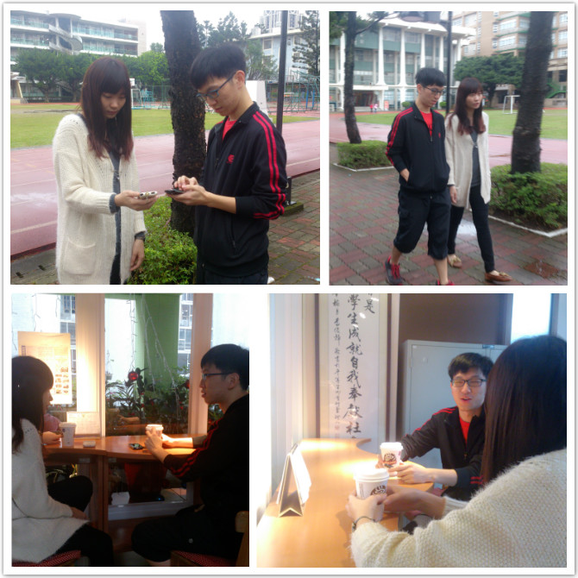
You can not only know more friends and maybe have a cup of coffee together.

Slide 15
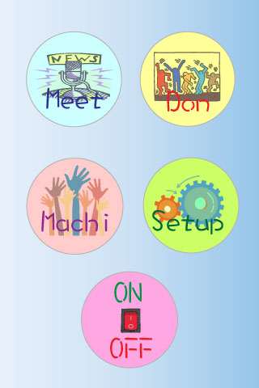
When you are busy you also can set your status to busy or offline

Slide 16

Don’t worry about the wrong match , it based on the information you provide. All comes from your taste.

Slide 17
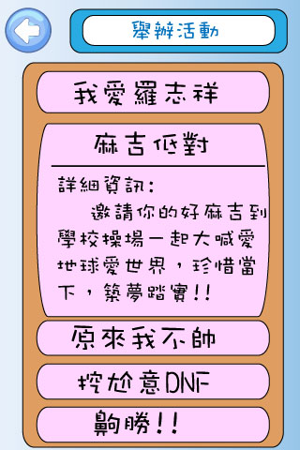
You can also have a party in this app and will invite users nearby.

Slide 18
THE END

